Slide 1



B2B E-Commerce CIS 579 – Technology of E-Business
Joseph H. Schuessler, PhD joseph.schuesslersounds.com Tarleton State University Stephenville, Texas schuessler@tarleton.edu

Slide 2
Learning Objectives
Describe the B2B field.
Describe the major types of B2B models.
Discuss the models and characteristics of the sell- side marketplace, including auctions.
Describe the sell-side intermediaries.
Describe the characteristics of the buy-side marketplace and e-procurement.
Explain how reverse auctions work in B2B.
Describe B2B aggregation and group purchasing models.

Slide 3
Learning Objectives
Describe other procurement methods.
Define exchanges and describe their major types.
Describe B2B portals.
Describe third-party exchanges.
Describe how B2B can benefit from social networking and Web 2.0.
Describe Internet marketing in B2B, including organizational buyer behavior.

Slide 4
Concepts, Characteristics,
and Models of B2B E-Commerce
business-to-business e-commerce (B2B EC)
Transactions between businesses conducted electronically over the Internet, extranets, intranets, or private networks; also known as eB2B (electronic B2B) or just B2B

Slide 5
Concepts, Characteristics,
and Models of B2B E-Commerce
THE BASIC TYPES OF B2B TRANSACTIONS AND ACTIVITIES
Sell-side
Buy-side
Exchanges
Supply chain improvements and collaborative commerce

Slide 6
Concepts, Characteristics,
and Models of B2B E-Commerce
THE BASIC TYPES OF B2B E-MARKETPLACES AND SERVICES
One-to-Many and Many-to-One: Private E- Marketplaces
company-centric EC
E-commerce that focuses on a single company’s buying needs (many-to- one, or buy-side) or selling needs (one-to- many, or sell-side)

Slide 7
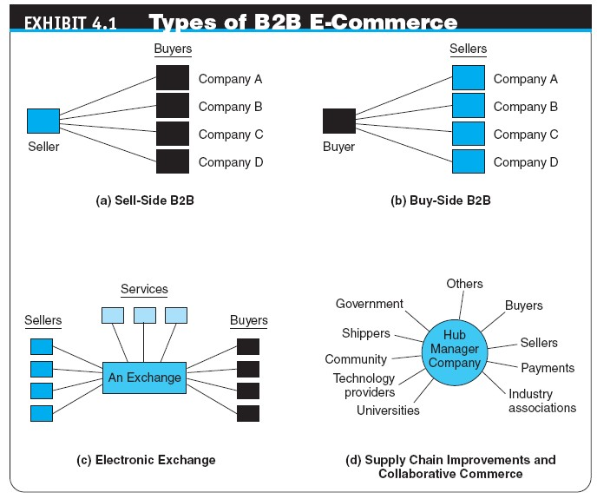

Slide 8
Concepts, Characteristics,
and Models of B2B E-Commerce
Many-to-Many: Public Exchanges
exchanges (trading communities or trading exchanges)
Many-to-many e-marketplaces, usually owned and run by a third party or a consortium, in which many buyers and many sellers meet electronically to trade with each other
public e-marketplaces
Third-party exchanges open to all interested parties (sellers and buyers)
Supply Chain Improvers and Collaborative Commerce

Slide 9
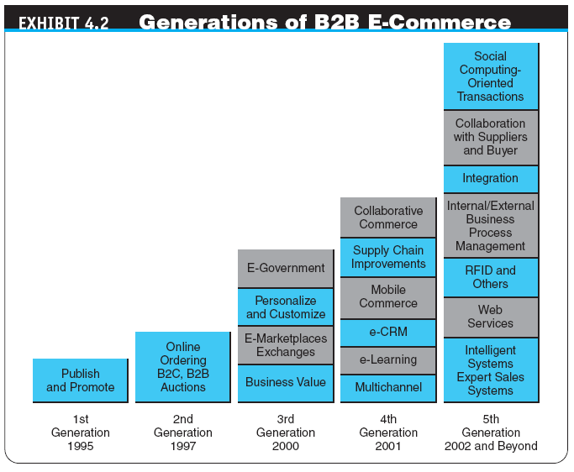

Slide 10
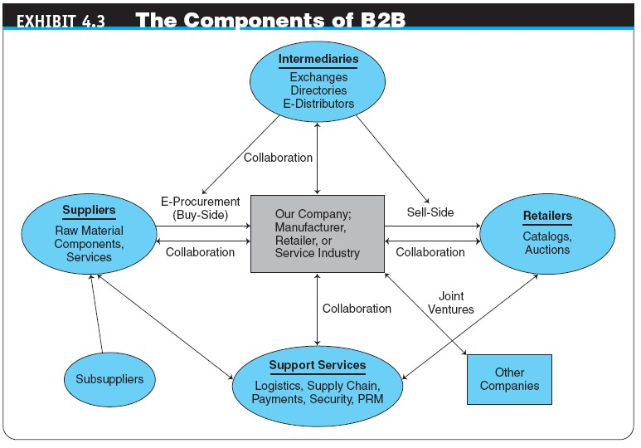

Slide 11
Concepts, Characteristics,
and Models of B2B E-Commerce
B2B CHARACTERISTICS
Parties to the Transaction: Sellers, Buyers, and Intermediaries
online intermediary
An online third party that brokers a transaction online between a buyer and a seller; may be virtual or click-and- mortar

Slide 12
Concepts, Characteristics,
and Models of B2B E-Commerce
Types of B2B Transactions: How Do Firms Buy?
spot buying
The purchase of goods and services as they are needed, usually at prevailing market prices
strategic (systematic) sourcing
Purchases involving long-term contracts that usually are based on private negotiations between sellers and buyers

Slide 13
Concepts, Characteristics,
and Models of B2B E-Commerce
Types of Materials Traded: What Do Firms Buy?
direct materials
Materials used in the production of a product (e.g., steel in a car or paper in a book)
indirect materials
Materials used to support production (e.g., office supplies or light bulbs)
MRO (maintenance, repair, and operation)
Indirect materials used in activities that support production

Slide 14
Concepts, Characteristics,
and Models of B2B E-Commerce
The Direction of the Trades
vertical marketplaces
Markets that deal with one industry or industry segment (e.g., steel, chemicals)
horizontal marketplaces
Markets that concentrate on a service, material, or a product that is used in all types of industries (e.g., office supplies, PCs)

Slide 15
Concepts, Characteristics,
and Models of B2B E-Commerce
SUPPLY CHAIN RELATIONSHIPS IN B2B
SERVICE INDUSTRIES ONLINE IN B2B
PARTNER AND SUPPLIER RELATIONSHIP MANAGEMENT
partner relationship management (PRM)
Business strategy that focuses on providing comprehensive quality service to business partners
supplier relationship management (SRM)
A comprehensive approach to managing an enterprise’s interactions with the organizations that supply the goods and services it uses.
THE BENEFITS AND LIMITATIONS OF B2B

Slide 16
One-to-Many:
Sell-Side E-Marketplaces
sell-side e-marketplace
A Web-based marketplace in which one company sells to many business buyers from e-catalogs or auctions, frequently over an extranet
B2B Sellers
Customer Service

Slide 17
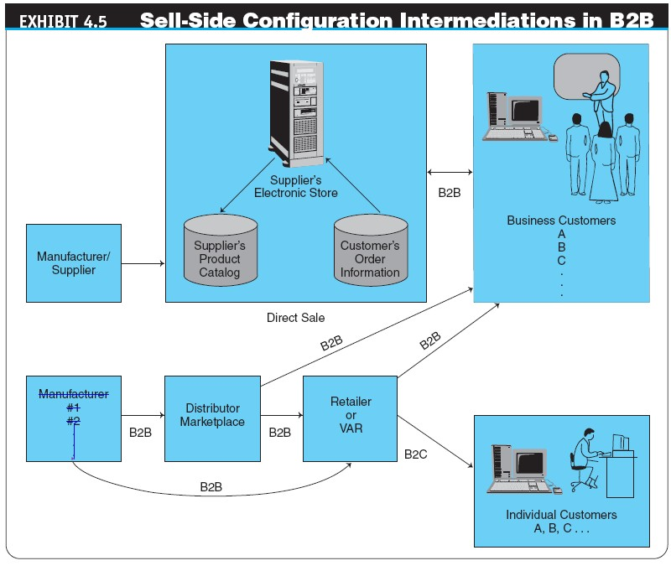

Slide 18
One-to-Many:
Sell-Side E-Marketplaces
SALES FROM CATALOGS: STOREFRONT
Customization and Self-Configuration
Benefits and Limitations of Online Sales from Catalogs
COMPREHENSIVE SELL-SIDE SYSTEMS

Slide 19
Selling Via Distributors
and Other Intermediaries
Manufacturers can sell directly to businesses, and they do so if the customers are large buyers.
Frequently they use intermediaries to distribute their products to a large number of smaller buyers.
The intermediaries buy products from many manufacturers and aggregate them into one catalog from which they sell to customers or to retailers.

Slide 20
Selling Via E-Auctions
USING AUCTIONS ON THE SELL SIDE
Revenue generation
Cost savings
Increased “stickiness”
Member acquisition and retention
AUCTIONING FROM THE COMPANY’S OWN SITE
USING INTERMEDIARIES IN AUCTIONS
EXAMPLES OF B2B FORWARD AUCTIONS

Slide 21
One-from-Many: E-Procurement
at Buy-Side E-Marketplaces
buy-side e-marketplace
A corporate-based acquisition site that uses reverse auctions, negotiations, group purchasing, or any other e-procurement method

Slide 22
One-from-Many: E-Procurement
at Buy-Side E-Marketplaces
INEFFICIENCIES IN TRADITIONAL PROCUREMENT MANAGEMENT
procurement management
The planning, organizing, and coordinating of all the activities relating to purchasing goods and services needed to accomplish the organization’s mission
maverick buying
Unplanned purchases of items needed quickly, often at non-prenegotiated higher prices

Slide 23
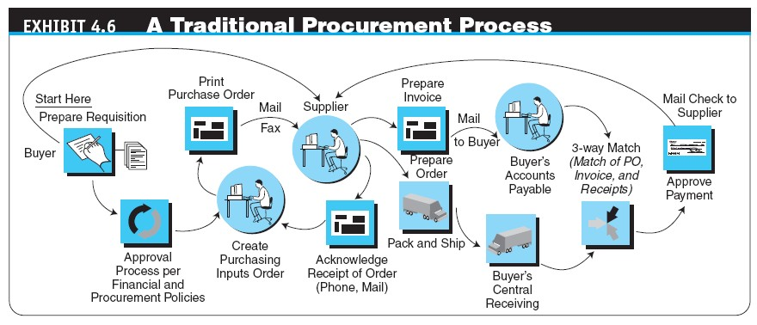

Slide 24
One-from-Many: E-Procurement
at Buy-Side E-Marketplaces
e-procurement (electronic procurement)
The electronic acquisition of goods and services for organizations via the Internet, EDI, etc.
THE GOALS AND PROCESS OF E-PROCUREMENT
Types of E-Procurement
E-sourcing
E-tendering
E-reverse auctioning
E-informing
Web-based ERP
E-market sites
E-MRO

Slide 25
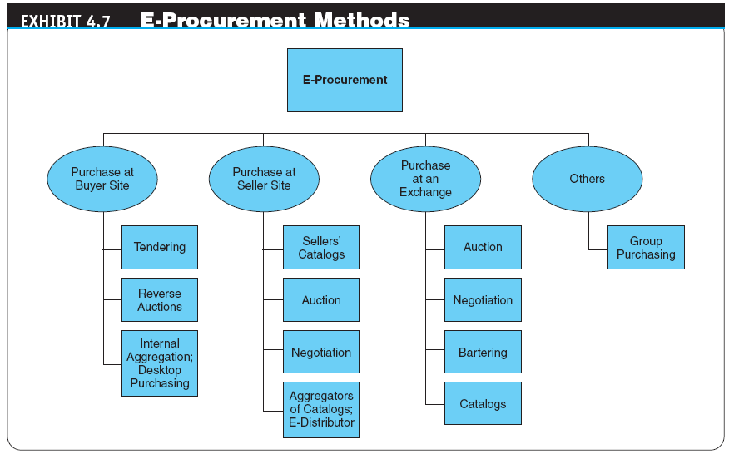

Slide 26
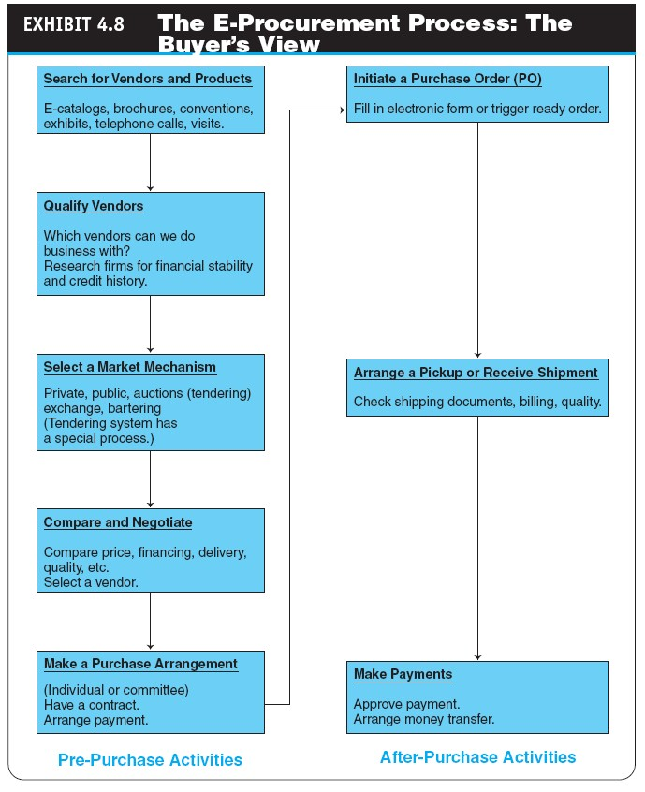

Slide 27
One-from-Many: E-Procurement
at Buy-Side E-Marketplaces
THE BENEFITS AND LIMITATIONS OF E- PROCUREMENT
The Benefits of E-Procurement
The Limitations and Challenges of E-Procurement

Slide 28
Reverse Auctions
at Buy-Side E-Marketplaces
request for quote (RFQ)
The “invitation” to participate in a tendering (bidding) system
CONDUCTING REVERSE AUCTIONS
E-Tendering by Governments
GROUP REVERSE AUCTIONS

Slide 29
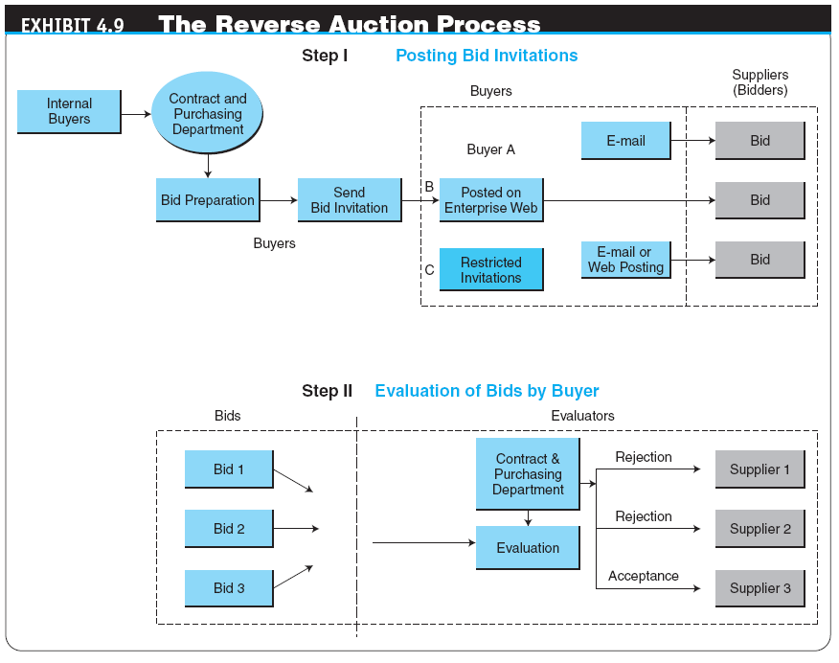

Slide 30
Other E-Procurement Methods
internal procurement marketplace
The aggregated catalogs of all approved suppliers combined into a single internal electronic catalog
Benefits of Internal Aggregated Catalogs
desktop purchasing
Direct purchasing from internal marketplaces without the approval of supervisors and without the intervention of a procurement department
4-30

Slide 31
Other E-Procurement Methods
group purchasing
The aggregation of orders from several buyers into volume purchases so that better prices can be negotiated
Internal Aggregation of Purchasing Orders
External Aggregation for Group Purchasing
4-31

Slide 32
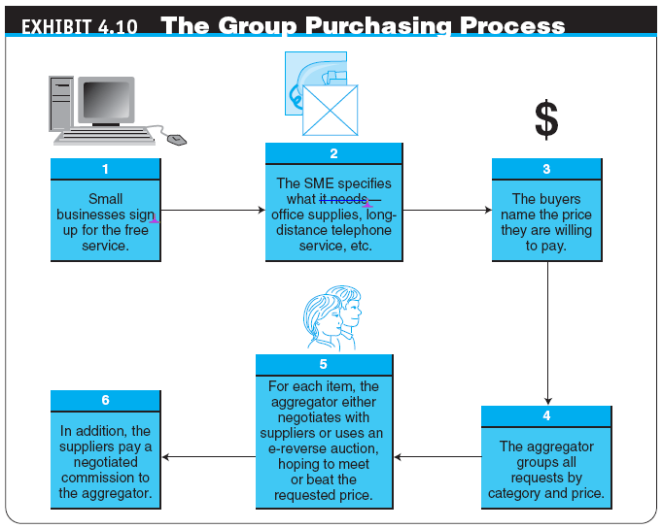
4-32

Slide 33
Other E-Procurement Methods
BUYING AT SELLERS’ SITES
Purchasing Direct Goods
ACQUISITION VIA ELECTRONIC BARTERING
bartering exchange
An intermediary that links parties in a barter; a company submits its surplus to the exchange and receives points of credit, which can be used to buy the items that the company needs from other exchange participants
SELECTING AN APPROPRIATE E-PROCUREMENT
SOLUTION
Copyright © 2012 Pearson Education, Inc.
Publishing as Prentice Hall
4-33

Slide 34
B2B Exchanges:
Definitions and Concepts
Functions of Exchanges
Matching buyers and sellers
Facilitating transactions
Maintaining exchange policies and infrastructure
Services Provided by Exchanges

Slide 35
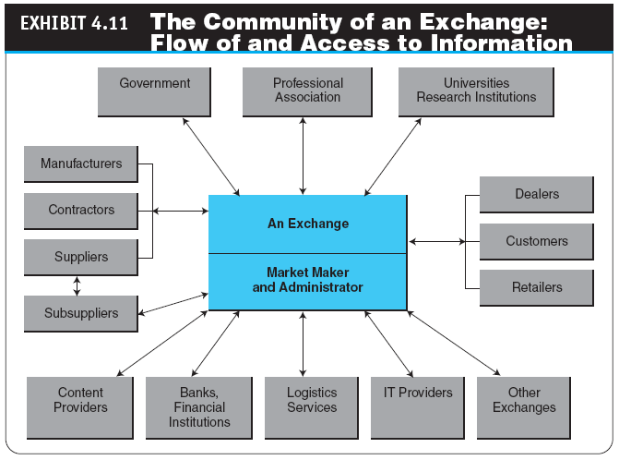

Slide 36
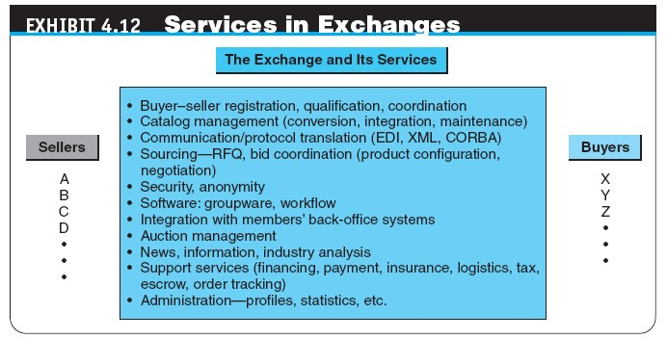

Slide 37
B2B Exchanges:
Definitions and Concepts
OWNERSHIP OF B2B EXCHANGES
Third-Party Independent Marketplaces
consortium trading exchange (CTE)
An exchange formed and operated by a group of major companies in an industry to provide industry-wide transaction services

Slide 38
B2B Exchanges:
Definitions and Concepts
DYNAMIC PRICING IN B2B EXCHANGES
dynamic pricing
A rapid movement of prices over time and possibly across customers, as a result of supply and demand matching
ADVANTAGES, LIMITATIONS, AND THE REVENUE MODEL OF EXCHANGES
Revenue Models

Slide 39
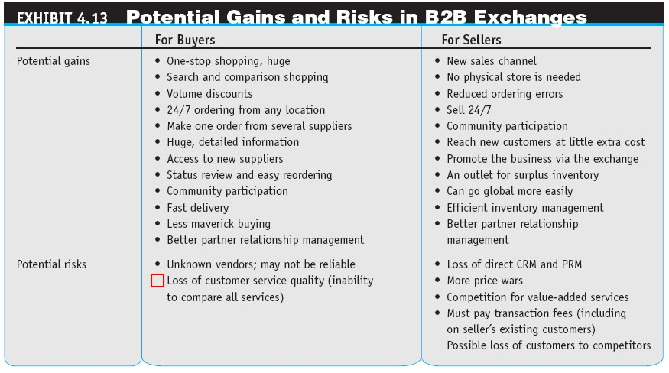

Slide 40
B2B Portals and Directories
B2B portals
Information portals for businesses
vortals
B2B portals that focus on a single industry or industry segment; “vertical portals”
4-40

Slide 41
B2B Portals and Directories
corporate (enterprise) portal
A major gateway through which employees, business partners, and the public can enter a corporate website
Examples
Types of Corporate Portals
Portals for Suppliers and Other Partners
Customer Portals
Employee Portals
Executive and Supervisor Portals
mobile portals
Portals accessible via mobile devices, especially cell phones and PDAs
4-41

Slide 42
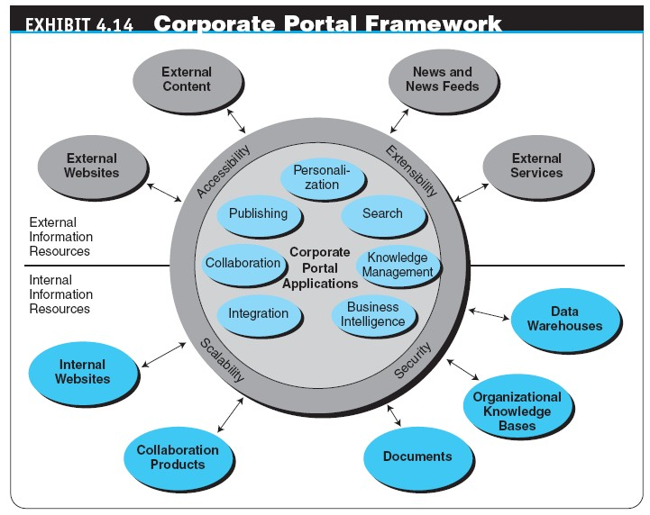
4-42

Slide 43
B2B Portals and Directories
The Functionalities of Portals
information portals
Portals that store data and enable users to navigate and query these data
collaborative portals
Portals that allow collaboration
Corporate Portal Applications and Issues
Directory Services and Search Engines
Thomas Register and ThomasNet
Alibaba.com
4-43

Slide 44
B2B In Web 2.0
and Social Networking
E-COMMUNITIES IN B2B
THE OPPORTUNITIES OF SOCIAL COMMERCE IN B2B
THE USE OF WEB 2.0 TOOLS IN B2B
4-44

Slide 45
B2B In Web 2.0
and Social Networking
SOCIAL NETWORKING IN B2B
EXAMPLES OF OTHER ACTIVITIES OF B2B SOCIAL NETWORKS
Success Stories
STRATEGY FOR B2B SOCIAL NETWORKING
THE FUTURE OF B2B SOCIAL NETWORKING
4-45

Slide 46
B2B Internet Marketing
B2B marketing
Marketing by manufacturers and wholesalers along the sell-side of the supply chain
ORGANIZATIONAL BUYER BEHAVIOR
A Behavioral Model of Organizational Buyers
THE MARKETING AND ADVERTISING PROCESSES IN B2B
4-46

Slide 47
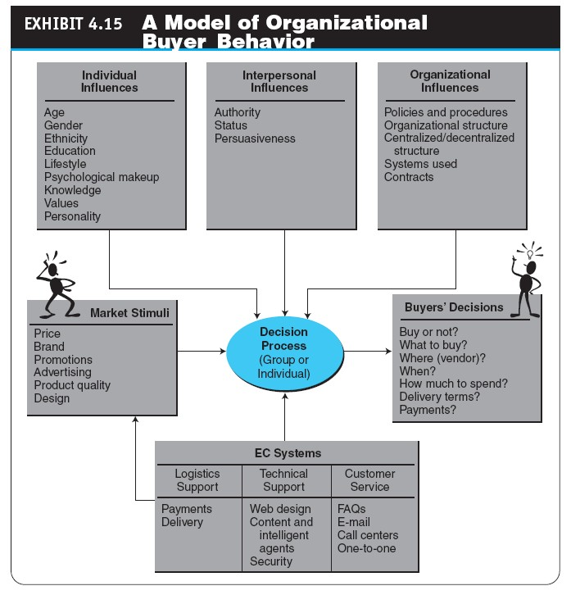
4-47

Slide 48
B2B Internet Marketing
METHODS FOR B2B ONLINE MARKETING
Targeting Customers
AFFILIATE PROGRAMS, MARKET RESEARCH, AND DATA MINING
Affiliate Programs
B2B Market Research
4-48

Slide 49
Managerial Issues
Which B2B model(s) should we use for e-procurement?
Which B2B model(s) should we use for online B2B sales?
Which exchange should we join?
Which solutions and vendor(s) should we select?
What is the organizational impact of B2B?
What are some ethical issues in B2B?
How shall we manage the suppliers?
Which type of social network should we use—private (proprietary) or public?
Can we use B2C marketing methods and research in
B2B?
Copyright © 2012 Pearson Education, Inc.
Publishing as Prentice Hall
4-49

Slide 50
Summary
The B2B field
The major B2B models
The characteristics and models of sell-side marketplaces
Sell-side intermediaries
The characteristics of buy-side marketplaces and e- procurement
B2B reverse auctions
B2B aggregation and group purchasing
4-50

Slide 51
Summary
Other procurement methods
Exchanges defined and the major types of exchanges
B2B portals
Third-party exchanges
B2B in Web 2.0 and social networks
B2B Internet marketing methods and organizational buyers
4-51

